Slide 1
DMS data analysis
Kai Hu
12/05/2019

Slide 2
Agenda
Deep Mutational Scanning (DMS) strategy
DMS analysis pipeline
Pipeline implementation
Setup
GUI mode
Command line mode
Examples

Slide 3
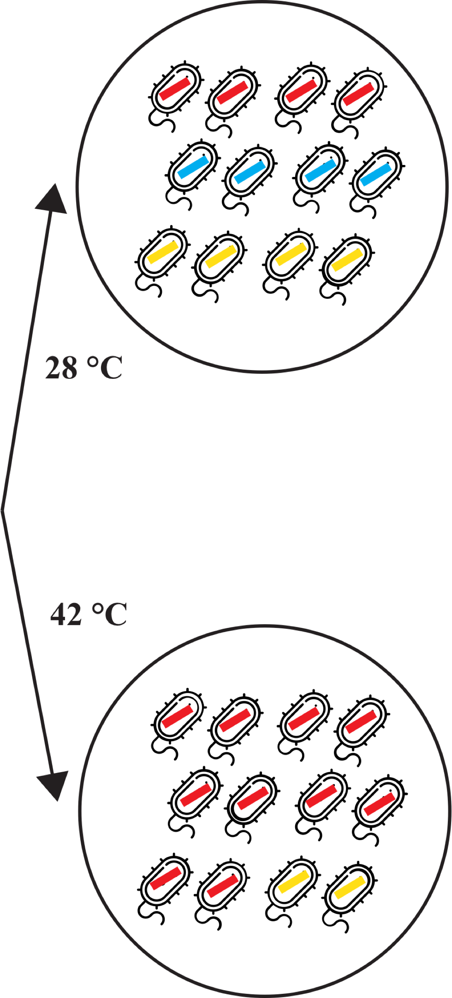
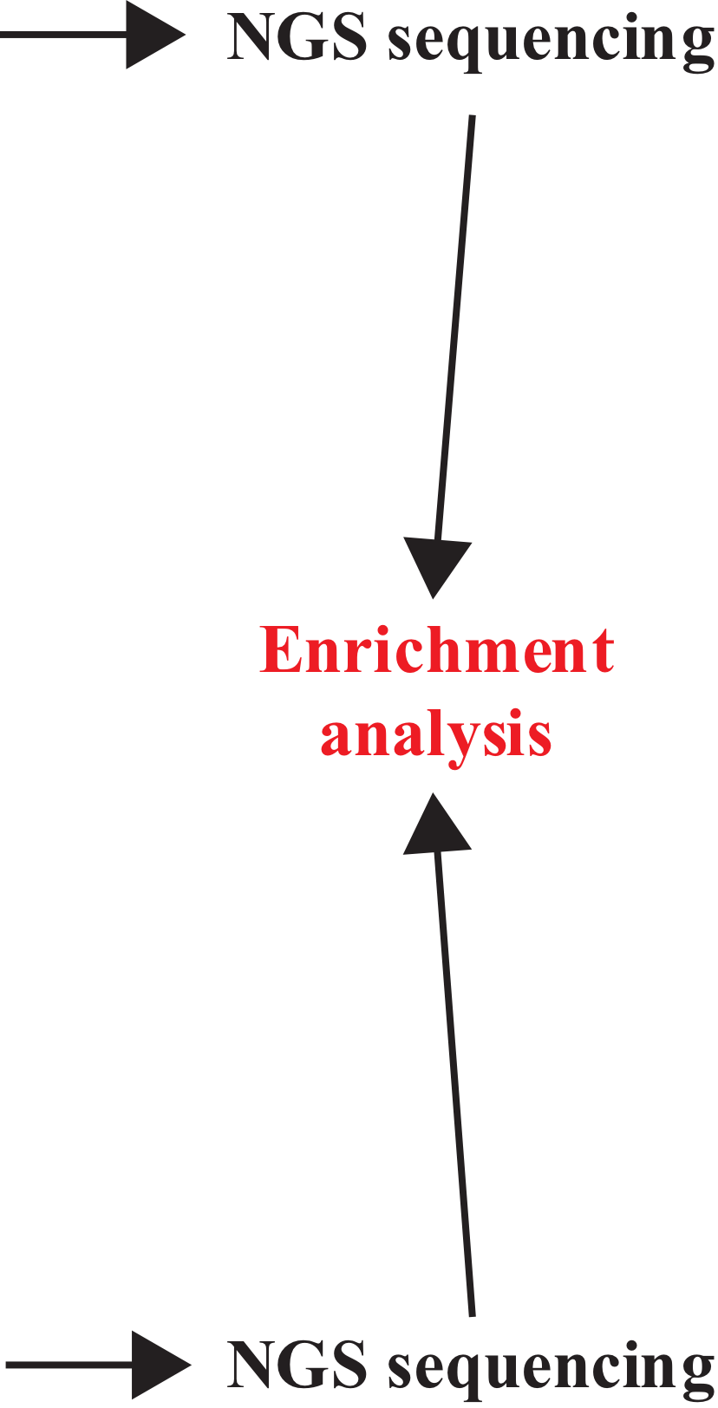
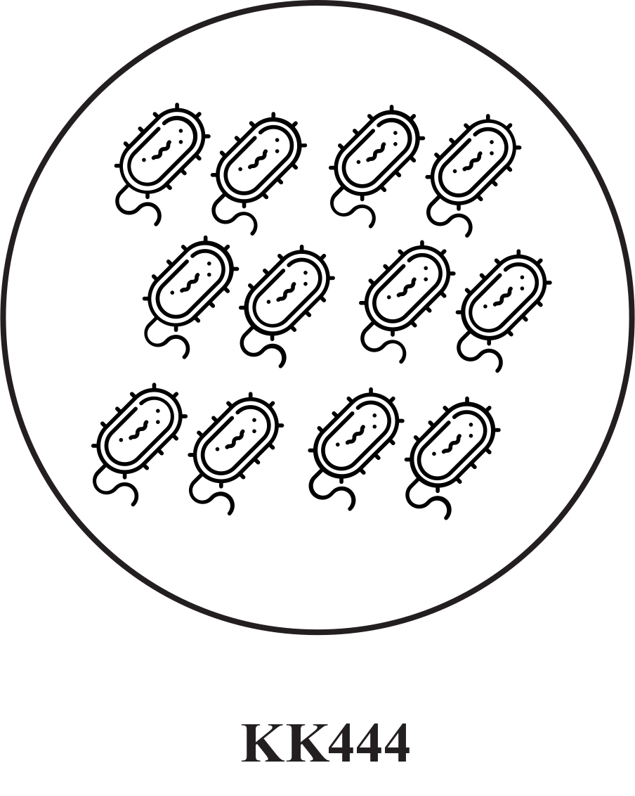
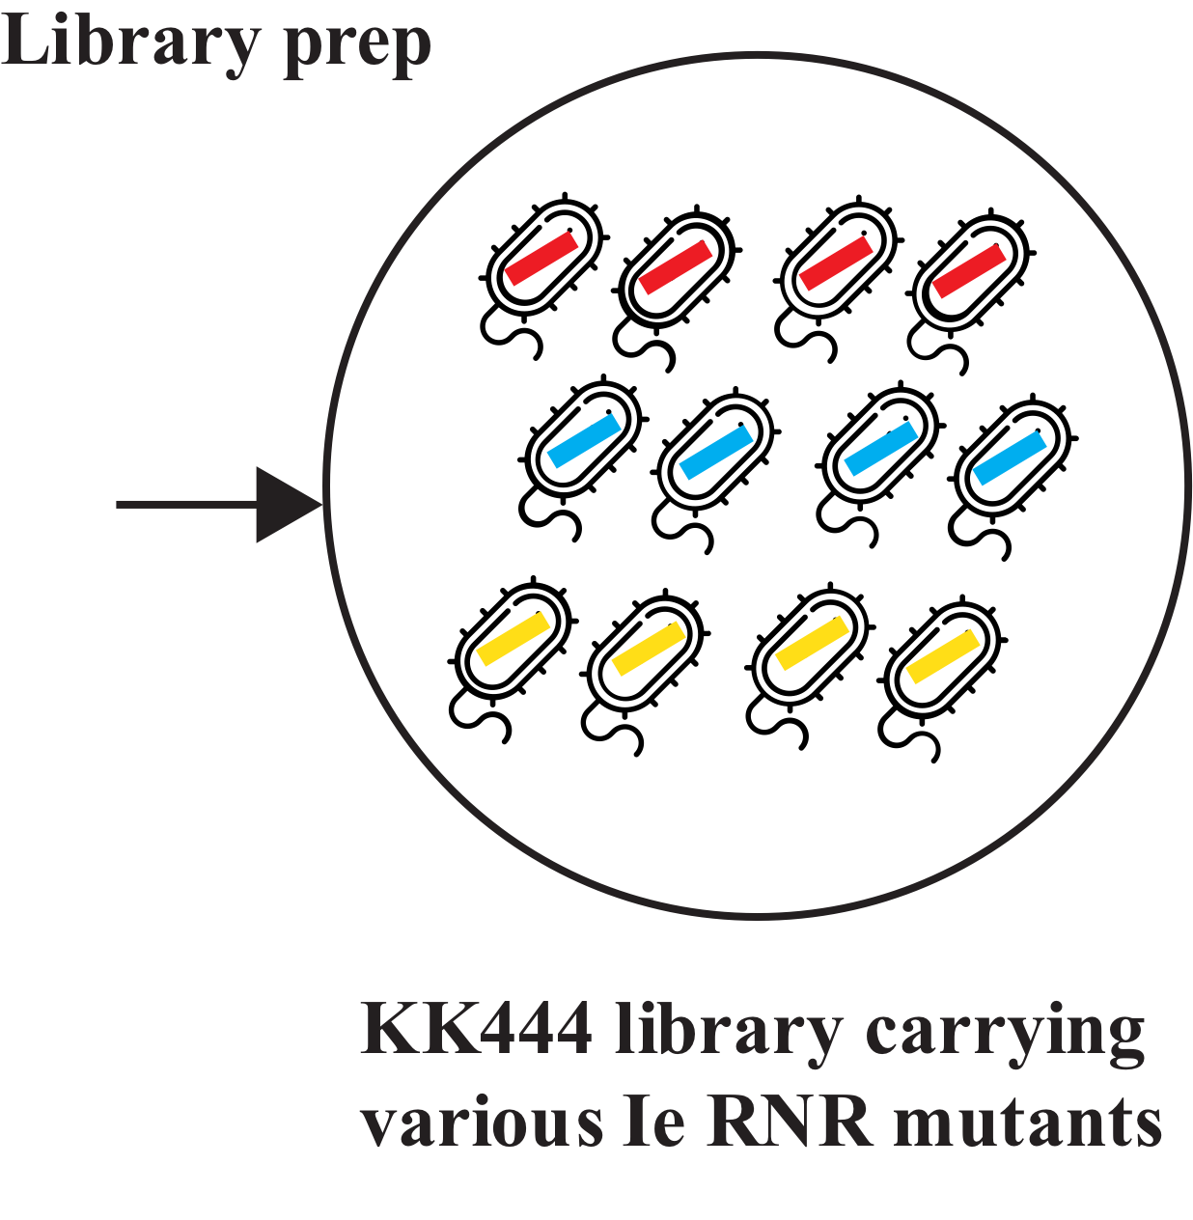
DMS strategy
Can be leveraged to examine the fitness landscape of mutants.

Slide 4
DMS analysis pipeline (with NGS data)
enrichment scores with Enrich2 (also contains count data)
raw bam files
data_sra
first_mapper
second_mapper
enrich_output
plot_output
raw NGS fastq
filtered bam files
(remove queries with INDELs/unexpected mutations)
Key intermediate files are shown above.

Slide 5
DMS analysis pipeline setup
Tested on MacOS 10.15.1 (Catalina).
0. Make sure Anaconda3 is installed:
https://www.anaconda.com/distribution/
1. Download the GitHub repo:
https://github.com/hukai916/DMS_project_v_2.5/archive/master.zip
2. Unzip the zip file
3. Navigate to the ‘script’ folder using Terminal
Under ‘script’ folder, do:
bash setup.sh

Slide 6
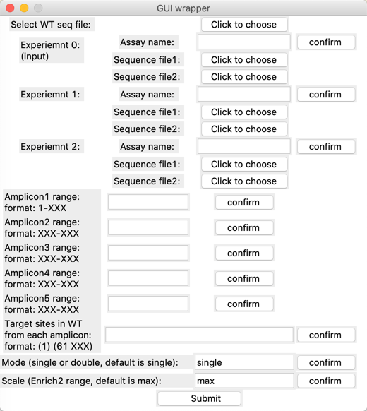
DMS analysis -- GUI mode
Under ‘script’ folder, do:
bash gui.sh
2. Fill in the required information and click ‘submit’ button
(Don’t put ‘-’ into ‘Assay name’)

Slide 7
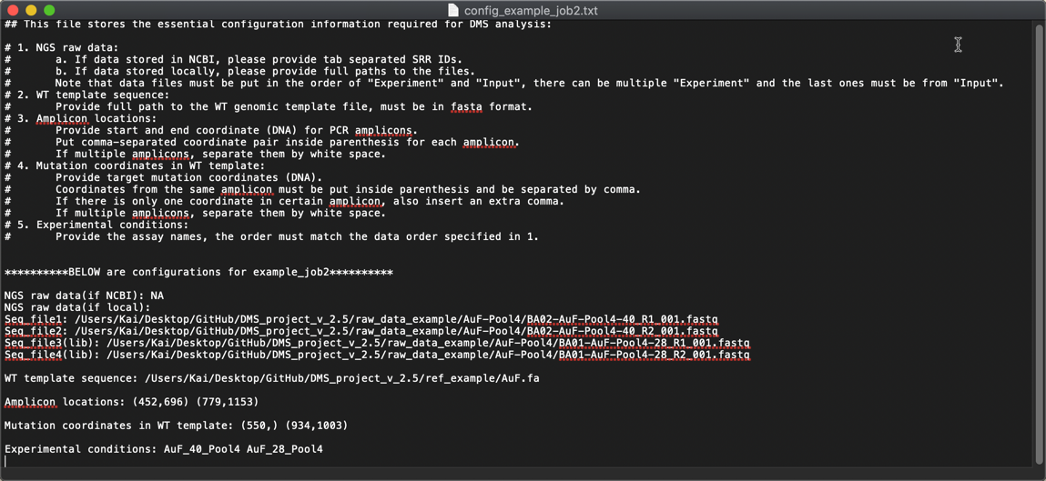
DMS analysis -- Command line mode
Under ‘script’ folder, do:
bash wrapper.sh -c=../config_file.txt
An example configuration file.

Slide 8
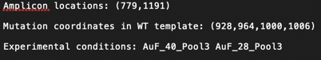
DMS analysis -- Example1 (AuF_pool3)
4 target mutation sites on one amplicon:
Result (aa-based plot):
Red: enriched
Blue: depleted
Dark Blue: total depletion
Gray: not enough data

Slide 9
DMS analysis -- Example1 (AuF_pool3)
Red: enriched
Blue: depleted
Dark Blue: total depletion
Gray: not enough data
Something seems wrong with site 334?
Check count file: enrich_output/aa_tsv/AuF_40_Pool3_1000_1002_GAT.tsv
https://github.com/hukai916/DMS_project_v_2.5/blob/master/result_example/job1/enrich2_output/aa_tsv/AuF_40_Pool3_1000_1002_GAT.tsv

Slide 10
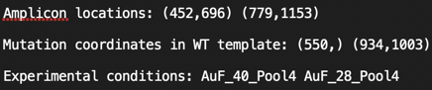
DMS analysis -- Example2 (AuF_pool4)
4 target mutation sites on two amplicons:
Result (aa-based plot):
Red: enriched
Blue: depleted
Dark Blue: total depletion
Gray: not enough data

Slide 11
Other features
Change color bar scale by setting -s flag or ‘Scale’ in GUI mode:
bash wrapper.sh -c=../config_example_job1.txt -s=1
Set to default
Set to 1
Double mutation mode by setting -m flag or ‘Mode’ in GUI mode:
bash wrapper.sh -c=../config_example_job1.txt -m=double

Slide 12
Clean intermediate files
Save your desired plots somewhere else before cleaning up all intermediate files using:
bash folder_clean.sh
(this will delete all job-specific files under the master directory making a clean space for next job)

Slide 13
Hands-on session
For more info, go to:
https://github.com/hukai916/DMS_project_v_2.5/blob/master/READEME.md
Questions and bugs send to Kai: hukai916@gmail.com

